Slide 1
"Always code as if the guy who ends up maintaining your code will be a violent psychopath who knows where you live."
John Woods.

Slide 2

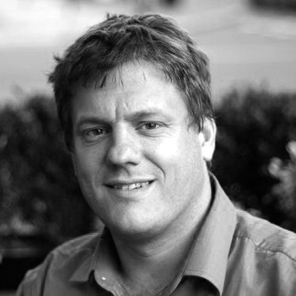
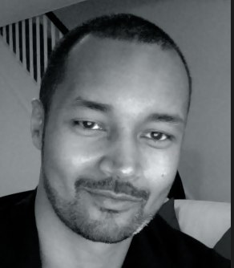
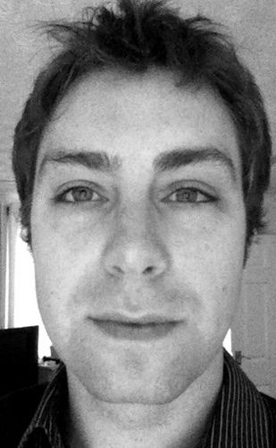
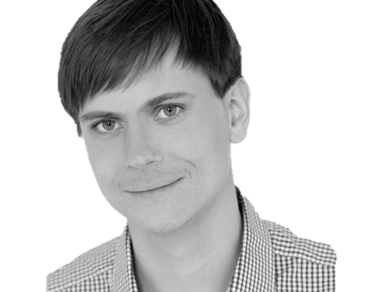

@riverglide
@andypalmer
@antonymarcano
@jmrtn
@pro_cessor

Slide 3

Ψ

Slide 4
Informatik
Keine Naturwissenschaft

Slide 5
Einstellungsähnlichkeit korreliert positiv mit DER interpersonellen Anziehung

Slide 6
Gleich und Gleich Einstellungsähnlichkeit korreliert positiv mit DER interpersonellen Anziehung gesellt sich gern

Slide 7
Die gravitationsbedingte vertikale Dislokation maliformer Agrarprodukte aus der Position ihrer Bio-Genese erfolgt in der Regel proxitrunkial

Slide 8

Der APFEL Fällt nicht Die gravitationsbedingte vertikale Dislokation maliformer Agrarprodukte aus der Position ihrer Bio-Genese erfolgt in der Regel proxitrunkial weit vom stamm

Slide 9
M a s c h i n e
Wir schreiben für die
anstatt für uns.

Slide 10
S
Open – Closed Principle
Liskov Substitution Principle
Interface Segregation Principle
Dependency Inversion Principle

Slide 11
S
O
Liskov Substitution Principle
Interface Segregation Principle
Dependency Inversion Principle

Slide 12
S
O
L
Interface Segregation Principle
Dependency Inversion Principle

Slide 13
S
O
L
I
Dependency Inversion Principle

Slide 14
S
O
L
I
D

Slide 15
S
O
L
I
D

Slide 16
S
O
L
I
D
Release-Reuse Equivalency Principle
Common Reuse Principle
Common Closure Principle
Acyclic Dependency Principle
Stable Abstractions Principle
Stable Dependencies Principle

Slide 17
S
O
L
I
D
RR
Common Reuse Principle
Common Closure Principle
Acyclic Dependency Principle
Stable Abstractions Principle
Stable Dependencies Principle

Slide 18
S
O
L
I
D
RR
CR
Common Closure Principle
Acyclic Dependency Principle
Stable Abstractions Principle
Stable Dependencies Principle

Slide 19
S
O
L
I
D
RR
CR
CC
Acyclic Dependency Principle
Stable Abstractions Principle
Stable Dependencies Principle

Slide 20
S
O
L
I
D
RR
CR
CC
AD
Stable Abstractions Principle
Stable Dependencies Principle

Slide 21
S
O
L
I
D
RR
CR
CC
AD
SA
Stable Dependencies Principle

Slide 22
S
O
L
I
D
RR
CR
CC
AD
SA
SD

Slide 23
S
O
L
I
D
RR
CR
CC
AD
SA
SD
Tell, don‘t ask
DRY
KISS
YAGNI

Slide 24
S
O
L
I
D
RR
CR
CC
AD
SA
SD
Tell, don‘t ask
DRY
KISS
YAGNI

Slide 25
S
O
L
I
D
RR
CR
CC
AD
SA
SD
Tell, don‘t ask
DRY
KISS
YAGNI

Slide 26
S
O
L
I
D
RR
CR
CC
AD
SA
SD
Tell, don‘t ask
DRY
KISS
YAGNI

Slide 27
S
O
L
I
D
RR
CR
CC
AD
SA
SD
Tell, don‘t ask
DRY
KISS
YAGNI

Slide 28
Separation
Machine
Domain
??

Slide 29
Empathie
Von Person zu Person

Slide 30
Empathy is the capacity to think and feel oneself into the inner life of another person
Heinz Kohut Psychoanalyst

Slide 31
Haltet EIN
Da kommt noch mehr!

Slide 32
Simple First
Paradigm-Commitment
Abstraction Segregation
Domain Relationship
Listening and Learning
Languages
Binary Dependency
Domain Language
Shared Under-standing
Eloquence
Patterns aren’t solutions
Weasel Word Removal

Slide 33
Simple First
Paradigm-Commitment
Abstraction Segregation
Domain Relationship
Listening and Learning
Languages
Binary Dependency
Domain Language
Shared Under-standing
Eloquence
Patterns aren’t solutions
Weasel Word Removal

Slide 34
Erst mal einfach
Simple First!
Richtig schwer!

Slide 35
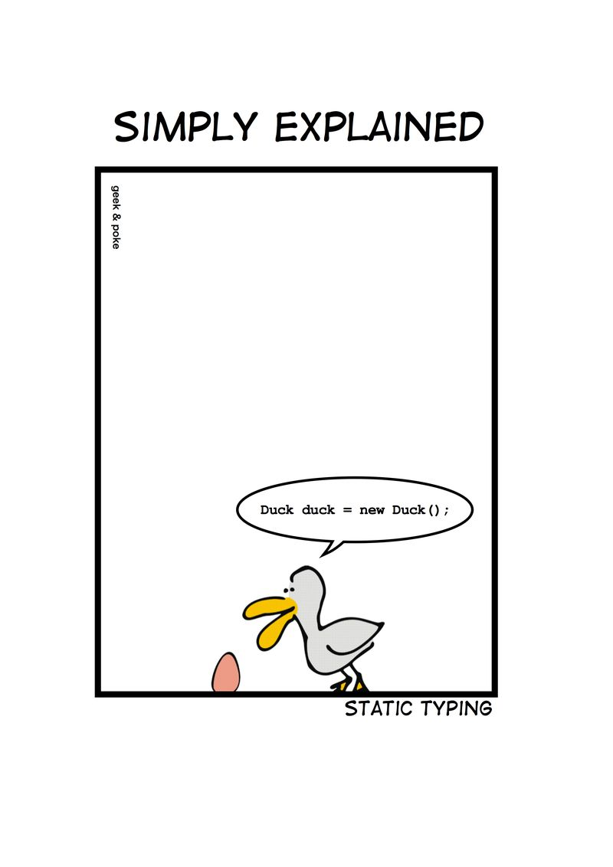

Slide 36
C# Duck duck = new Duck();

Slide 37
Python duck = Duck()

Slide 38
C# - DRY var duck = new Duck();

Slide 39
Zug.un.glück
Es steht ein
bevor

Slide 40
Don’t ASK
Tell.
Or: The Law of Demeter

Slide 41
if(Customer.Email.Address.Value.IsValid) { Send(Customer.Email.Address, message); }

Slide 42
if(Customer.IsEmailValid()) { Send(Customer.Email.Address, message); }

Slide 43
Customer.Send(message)

Slide 44
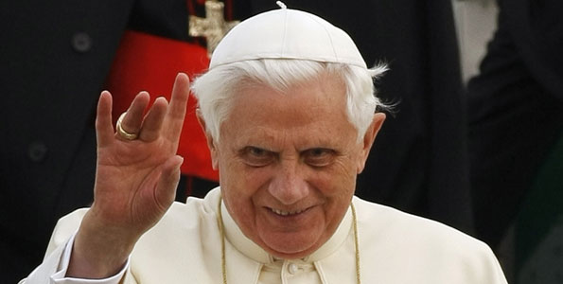
Don’t let a stranger touch your privates

Slide 45
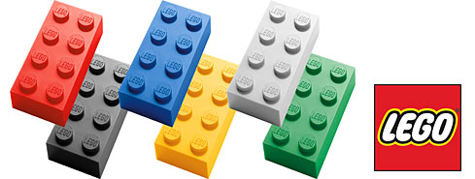
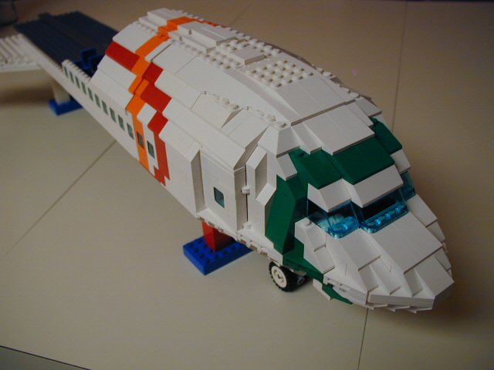
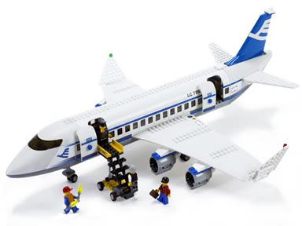
Size & Reuse

Slide 46
überraschungen
Keine
Was erwartest du?

Slide 47
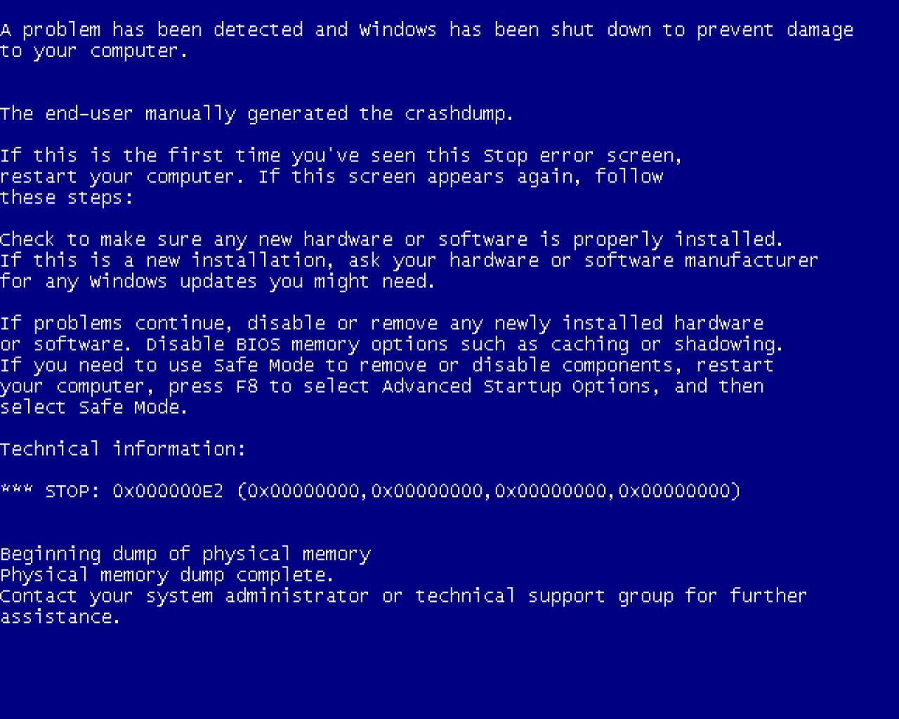
Notes:
Diese Folie ist ein Nullobjekt

Slide 48
Notes:
Diese Folie ist ein Nullobjekt

Slide 49
NullObjekte

Slide 50
Spüre deinen Code
Man sieht nur mit dem Herzen gut

Slide 51
public void Execute(MainViewModel mainViewModel) { mainViewModel.Done = () => Break(mainViewModel); mainViewModel.StartCounter(); } public void Break(MainViewModel model) { model.Color = 0x00DBFF.Rgb().Brush(); model.TimeLeft = 5.Minutes(); model.Done = () => Work(model); model.StartCounter(); } public void Work(MainViewModel model) { model.Color = 0x00DB00.Rgb().Brush(); model.TimeLeft = 25.Minutes(); model.Done = () => Break(model); model.StartCounter(); }

Slide 52
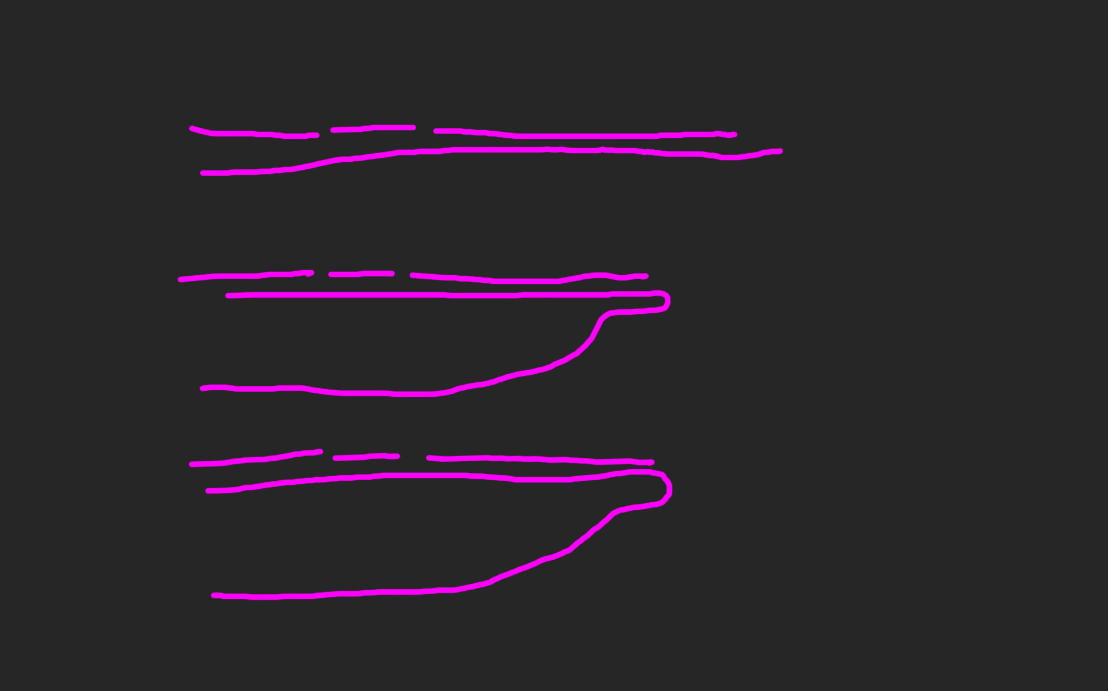
public void Execute(MainViewModel mainViewModel) { mainViewModel.Done = () => Break(mainViewModel); mainViewModel.StartCounter(); } public void Break(MainViewModel model) { model.Color = 0x00DBFF.Rgb().Brush(); model.TimeLeft = 5.Minutes(); model.Done = () => Work(model); model.StartCounter(); } public void Work(MainViewModel model) { model.Color = 0x00DB00.Rgb().Brush(); model.TimeLeft = 25.Minutes(); model.Done = () => Break(model); model.StartCounter(); }

Slide 57
def filter(markup): return add_twitter_names(markup) def add_twitter_names(markup): pattern = "@(\w+)" url = "https://twitter.com/" link = "<a href='%s\\1'>@\\1</a>" % url replacement = link return re.sub(pattern, replacement, markup) def home(entries): markup = create_page(entries) markup = filter(markup) return markup def main(): entries = Entries() if len(argv) > 1: date = argv[1] entries = entries.written_on(date) print home(entries)

Slide 58
metrik
Die einfachste
für die C-Familie

Slide 59
Signature Survey Datei (<loc>): { ; }

Slide 60
ExitWindowsFlags.cs (17): ;{{}} FullScreen.cs (10): {{{;}}} HexToColorExtension.cs (30): ;{{{;}{;}{;}}} Hibernate.cs (23): ;{{{}{}{;;;;}}} ICanBeSelected.cs (10): ;;{{;}} ICanStartAndStop.cs (12): ;{{{;;};;}} IExecute.cs (10): ;;{{;}} IHaveGotTheTime.cs (9): ;{{{;}}} IntToTimespanExtension.cs (26): ;{{{;}{;}{;}}} InvisibilityConverter.cs (20): ;;;;{{{;}{;}}} IShutdownTheSystem.cs (7): {{;}} IWindowsFunctions.cs (9): {{;;;}} KeyExtension.cs (17): ;{{{;}{;}}} Lock.cs (20): ;{{{}{}{;}}} LogOff.cs (21): ;{{{}{}{;;}}} MainViewModel.cs (103): ;;;;;;{{;;;;;;;;;{;;;}{{;}{;}}{{;}{;}}{{;}{;}}{{;}{;}}{;;;;;}{;;}{;}{;{;;}}{;}{;;}{;;;;}}} MainWindow.xaml.cs (42): ;;;;;{{;{;;;}{{;}}{;;;}{;;}}} MenuItemExtension.cs (17): ;;;{{{{;}}}} MouseWheelGesture.cs (56): ;{{{}{}{;;}{{{};}}{{{};}}{{{};}}{{{};}}{;;;{;;;;}}}} MutuallyExclusiveCheckBoxes.cs (42): ;;{{{;}{;}{;;;;}{;}{;}{;}}} PlaySound.cs (23): ;;;;;{{{{;}{;}}}} PomodoroTimer.cs (33): ;;;{{{;;}{;;;;}{;;;;}}} RegisterShutdownEvent.cs (12): ;{{{;}}} RegisterTimeoutEvent.cs (23): ;{{{;;}{;}{;}}} ResetTimer.cs (21): ;;;{{;{;}{;}}} Restart.cs (21): ;{{{}{}{;;}}} RestartTimer.cs (21): ;;{{;{;}{;;}}} SetColor.cs (37): ;{{;{;;;;;;}{;;}}} SetTime.cs (18): ;;{{{;}{;}}} Shutdown.cs (21): ;{{{}{}{;;}}} ShutdownReason.cs (47): ;{{}} Sleep.cs (23): ;{{{}{}{;;;;}}} Start.cs (10): {{{;}}} Stop.cs (10): {{{;}}} TimeSpanExtensions.cs (12): ;{{{;}}} Toggle.cs (13): ;{{{;;}}} ViewCommand.cs (15): ;;{{{;;}{;}}} ViewModel.cs (39): ;;;{{{;;}{{};}{{};;;}}} ViewModelBaseWeasel.cs (29): ;;{{;{;;;}{;;;}}} VisibilityConverter.cs (20): ;;;;{{{;}{;}}} Wheel.xaml.cs (20): ;;;{{{;}{;;}}} WheelDirection.cs (9): {{}}

Slide 61
LogOff.cs (21): ;{{{}{}{;;}}} MainViewModel.cs (103): ;;;;;;{{;;;;;;;;;{;;;}{{;}{;}}{{;}{;}}{{;}{;}} MainWindow.xaml.cs (42): ;;;;;{{;{;;;}{{;}}{;;;}{;;}}} MenuItemExtension.cs (17): ;;;{{{{;}}}} MouseWheelGesture.cs (56): ;{{{}{}{;;}{{{};}}{{{};}}{{{};}}{{{};}}{;;;{ MutuallyExclusiveCheckBoxes.cs (42): ;;{{{;}{;}{;;;;}{;}{;}{;}}}

Slide 62
philosophie
Code
Und Maximen

Slide 63
>>> import this

Slide 64
If the implementation is hard to explain, it's a bad idea.
python

Slide 65
Zuhören
Richtig
und dabei lernen!

Slide 66
Wir brauchen einen Automocker.

Slide 67
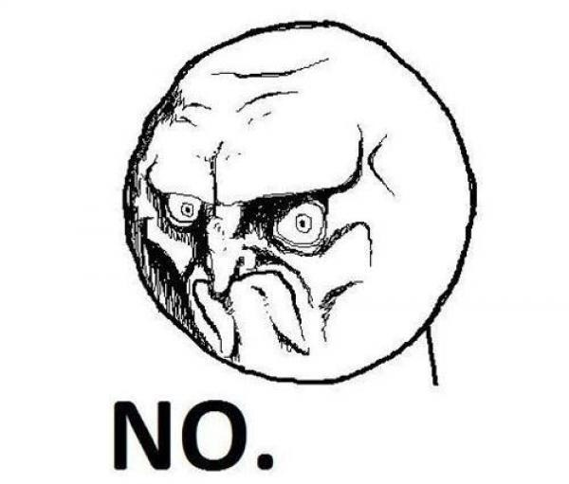

Slide 68
Diese klasse ist schwer zu testen.

Slide 70
Das gleiche sagen
Shared Understanding
vom selben Elephanten

Slide 71
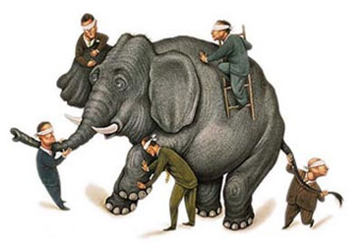

Slide 72
Simple First
Paradigm-Commitment
Abstraction Segregation
Domain Relationship
Listening and Learning
Languages
Binary Dependency
Domain Language
Shared Under-standing
Eloquence
Patterns aren’t solutions
Weasel Word Removal

Slide 73
IM PARADIGMA BLEIBEN
Unabhängig von der Sprache
Und es verstehen

Slide 74
Objekte Funktionen

Slide 75
Sprachen
Polyglott
C#, F#, Prolog, Io, Haskell, Brainfuck, Python, Ruby, Javascript, Lisp, Smalltalk, C++, C, Java, Groovy, Scala, Clojure, Perl, R

Slide 76
Vielleicht ist deine ProgrammierSprache ungeeignet, um es genau so zu tun

Slide 77
https://github.com/cessor/refuctoring

Slide 78
private static TimeSpan Transform(this IEnumerable<int> digits) { int result = 0; var r = digits.ToList(); for (int j = 0; j < r.Count; j++) { int i = (int)Math.Pow(60, j / 2); int rTimesI = r[r.Count - j - 1] * i; result += (j % 2 == 1) ? rTimesI * 10 : rTimesI; } return TimeSpan.FromSeconds(result); }

Slide 79
private static TimeSpan Transform(this IEnumerable<int> digits) { var secondsPerUnit = new [] { 1,10,60,600,3600,36000 }; return digits .Reverse() .Zip(secondsPerUnit, (digit, unit) => digit * unit) .Sum() .Seconds(); }

Slide 80
Natürliche
Gesprochene,
Sprache

Slide 81
var date = new DateTime (2012, 4, 14, 16, 32, 18, 500);

Slide 82
var start = 14.April(2012).At(8.PM()); var end = 8.Hours().Later(start);

Slide 83
Sprachfertigkeit
Eloquenz
Eine Sprache richtig sprechen

Slide 84
Wenn du mir erklären kannst, was da passiert, wieso steht das da dann nicht?

Slide 85
[Test] public void ShouldConvertAnEvenNumberOfDigitsToATimespan() { // Arrange var bytes = new byte[] { 0, 0, 1,5, 0,5 }; var expected = new TimeSpan(0, 0, 15, 5, 0); // Act var actual = Transform(bytes); // Assert actual.Should().Equal(expected); }

Slide 86
When.IType(1, 5, 0, 5).And() .TransformTheDigits() .Then().TheResult().Should().Equal( 15.Minutes().And(5.Seconds()) );

Slide 87
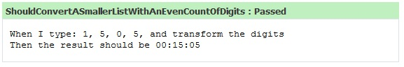

Slide 88
Simple First
Paradigm-Commitment
Abstraction Segregation
Domain Relationship
Listening and Learning
Languages
Binary Dependency
Domain Language
Shared Under-standing
Eloquence
Patterns aren’t solutions
Weasel Word Removal

Slide 89
Abstraktion
Trennen von Einzelheiten
in Domäne und Maschine

Slide 90
for int i=0; GetCustomer

Slide 91
Exceptionell,
Ist etwas
Wenn du es erwartest?

Slide 92
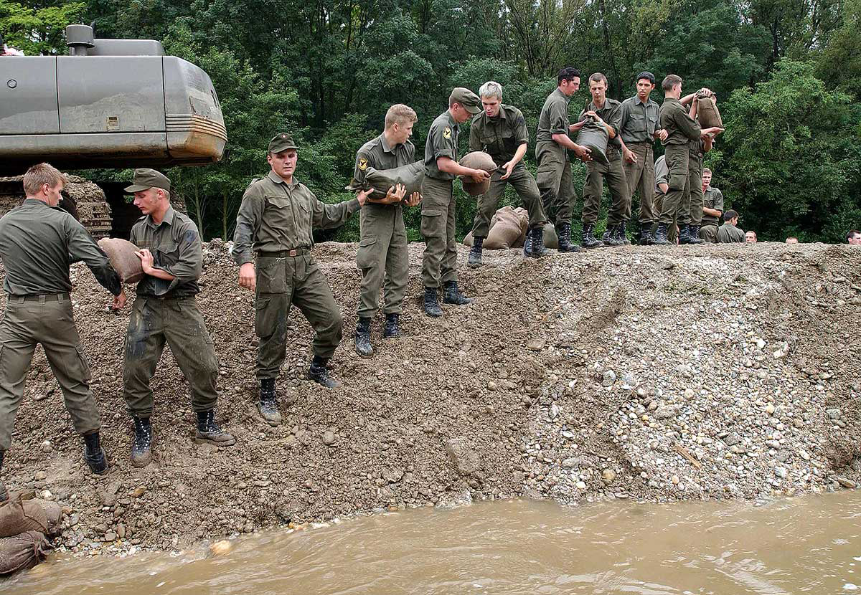

Slide 93
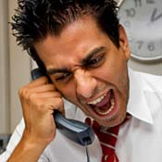
Complaints
Beschwerden
Wenn ein Problem besteht

Slide 94
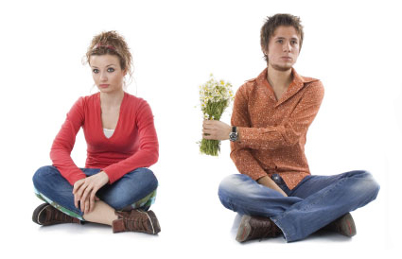
Apologies
Entschuldigung
Wenn es verzeihbar ist

Slide 95
Binäre Abhängigkeit
x = 1 + 2
Meist reicht das.

Slide 96
Imports Parameter Binäre Bäume

Slide 97
Entwurfsmuster
Design Patterns
Sind keine Lösung

Slide 98
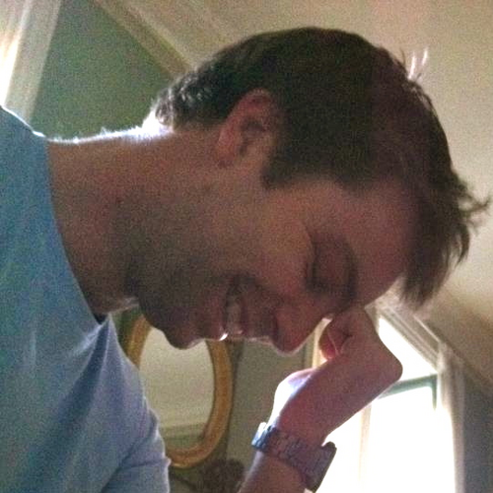
https://twitter.com/#!/jmrtn http://jmrtn.com/notes/2012/02/17/design-patterns.html

Slide 99
Simple First
Paradigm-Commitment
Abstraction Segregation
Domain Relationship
Listening and Learning
Languages
Binary Dependency
Domain Language
Shared Under-standing
Eloquence
Patterns aren’t solutions
Weasel Word Removal

Slide 100
DomänenBEZUG
Wenn du darüber sprichst…
…ist es wahrscheinlich wichtig

Slide 101
Email Adressen sind keine Strings

Slide 102
TinY TYpes

Slide 103
Dinge müssen nicht können aber sie können sein

Slide 104
Email InvalidEmail

Slide 105
Polymorphismen Typen

Slide 106
Domänensprache
Ubiquitous Language
Gegen Babylonische Sprachverwirrung

Slide 107
Systemische Metapher Klare Namen

Slide 108
Simple First
Paradigm-Commitment
Abstraction Segregation
Domain Relationship
Listening and Learning
Languages
Binary Dependency
Domain Language
Shared Under-standing
Eloquence
Patterns aren’t solutions
Weasel Word Removal

Slide 109
Managerbrokerdispatcher interfaceimpl

Slide 110
http://www.classnamer.com/

Slide 111
CheckedGraphContext Stateles ErrorCorrectingMessageGeneratorsRecordGenerator

Slide 112
Clean code *
*The book!

Slide 113
intentionrevealing
Use
Names
ABSICHTSVERMITTELNDE

Slide 114
DEsinformation
Vermeide

Slide 115
aussagekräftige
Erzeuge
Unterschiede

Slide 116
Suchbare
Verwende
Namen

Slide 117
aussprechbare
Verwende
Namen

Slide 118
private Date genymdhms

Slide 119
private Date generationTimestamp

Slide 120
/// <summary> /// Gets or sets. /// Used for Ewiomc. /// </summary> /// <remarks> /// Used internally by the bl. /// </remarks> public string Vdewgvgwid { get; set; } WTF? Ich geh heim.

Slide 121
Klassennamen
Aussage
kräftig

Slide 122
“Classes and objects should have noun or noun phrase names like customer, WikiPage, Account, and Addressparser. Avoid words like manager, Processor,, Data, or Info in the Name of a class. A class Name should not be a verb.”

Slide 123
“Classes and objects should have noun or noun phrase names like customer, WikiPage, Account, and Addressparser. Avoid words like manager, Processor,, Data, or Info in the Name of a class. A class Name should not be a verb.”

Slide 124
“Classes and objects should have noun or noun phrase names like customer, WikiPage, Account, and Addressparser. Avoid words like manager, Processor,, Data, or Info in the Name of a class. A class Name should not be a verb.”

Slide 125
“Classes and objects should have noun or noun phrase names like customer, WikiPage, Account, and Addressparser. Avoid words like manager, Processor,, Data, or Info in the Name of a class. A class Name should not be a verb.”

Slide 126
“Classes and objects should have noun or noun phrase names like customer, WikiPage, Account, and Addressparser. Avoid words like manager, Processor, Data, or Info in the Name of a class. A class Name should not be a verb.”

Slide 127
WAR
UM?

Slide 128
Deinen feind
Kenne
Und respektiere ihn.

Slide 129
Weasel Words

Slide 130
“I can suck melancholy out of a song, as a weazel sucks eggs.”
Shakespeare, as you like it, ii. 5..

Slide 131
Taxonomie
Klassifikation
Ordnung

Slide 132
Hungarian
Party Hats
Philo
sophers

Slide 133
Double int long string

Slide 134
pWindow cCustomers

Slide 135
[DllImport("user32.dll")] static extern bool CloseWindow(IntPtr hWnd);

Slide 136
[DllImport("user32.dll", SetLastError=true)] static extern IntPtr CreateWindowEx( WindowStylesEx dwExStyle, string lpClassName, string lpWindowName, WindowStyles dwStyle, int x, int y, int nWidth, int nHeight, IntPtr hWndParent, IntPtr hMenu, IntPtr hInstance, IntPtr lpParam);

Slide 137
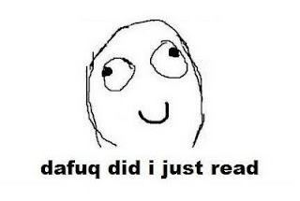

Slide 138
public int SumIntegersUpTo(int bound) { return Enumerable.Range(1, bound).Sum(); }

Slide 139
private readonly ICanStartAndStop _counter; private readonly Wristwatch _wristwatch; private Brush _color; private double _fontSize; private bool _isRunning = false; private TimeSpan _timeLeft;

Slide 140
Hungarian
Party Hats
Philo
sophers

Slide 141
for(int i = 0; i < customers.Count; i++) { Customer theCustomer = customers[i]; ... }

Slide 142
foreach(var customer in customers) { ... }

Slide 143
MehrfachEn
Hilfsmittel zur
Vergabe des selben Namens

Slide 144
my

Slide 145
THE

Slide 146
AN

Slide 147
IT

Slide 148
Hungarian
Party Hats
Philo
sophers

Slide 149
Data Info

Slide 150
Function Process

Slide 151
System Model

Slide 152
Vanity
Details

Slide 153
IMPORTANCE
Eitle Wichtigtuer
Aufgeblasen!

Slide 154
Flexible General

Slide 155
Extended Super

Slide 156
ABSTRACT

Slide 157
public abstract class AbstractTopLevelItem extends AbstractItem implements TopLevelItem { // ... }

Slide 158
Simplicity
Die Schönheit liegt
im Auge des Betrachters

Slide 159
Basic Easy

Slide 160
New Special

Slide 161
Simple

Slide 162
Vanity
Details

Slide 163
Shape
Mit Förmchen spielen…
Details

Slide 164
List Query Array Dictionary VIEW

Slide 165
BehaviorAL
Benimm dich!
Details

Slide 166
Dynamic Lazy Local Constant Global

Slide 167
Test
Klappts?
Details

Slide 168
MOCK Stub Fake

Slide 169
DynamicMOCK STricktmock

Slide 170
Mocks
Sind keine Stubs.

Slide 171
var stubUserRepository = MockRepository.GenerateStub<IUserRepository>(); stubUserRepository.Stub(x => x.GetUserByName("ayende")).Return(theUser);

Slide 172
Roles
Patterns

Slide 173
Eager
PoEAA
Lazy
GoF
Charity
DDD

Slide 174
Eager Roles
Übereifrig
Tausendsassa

Slide 175
Provider Agent

Slide 176
Dispatcher Broker

Slide 177
MANAGER

Slide 178
Prozeduraler Code Große klassen

Slide 179
Schwer Testbar 1000+Loc

Slide 180
Jenkins https://github.com/jenkinsci/jenkins/blob/master/core/src/main/java/jenkins/model/Jenkins.java

Slide 181
Lazy Roles
Faulpelze
Nicht meine Aufgabe!

Slide 182
Nomina Agentis
Von einem Verb
abgeleitetes Substantiv

Slide 183
Derivationsmorpheme

Slide 184
-er -or

Slide 185
Formatter Transformer

Slide 186
Wrapper Mapper

Slide 187
Validator

Slide 188

Charity

Slide 189
Utils Helper

Slide 190
“We are blind to the World within us, Waiting to be born”
AT THE GATES Blinded By FEAR

Slide 191
Roles
Patterns

Slide 192
Eager
PoEAA
Lazy
GoF
Charity
DDD

Slide 193
Entwurfsmuster
Design Patterns
Sind keine Lösung

Slide 194
Builder Facade Strategy Decorator

Slide 195
Singleton

Slide 196
var instance = ConnectionSingleton.Instance;

Slide 197
public static DatabaseConnectionSingleton GetInstance() { return _instance ?? (_instance = new DatabaseConnectionSingleton()); }

Slide 198
New, Delete? Kann das nicht die Runtime machen?

Slide 199
var instance = Only.One<DatabaseConnection>();

Slide 200
var instance = The.Same<DatabaseConnection>();

Slide 201
var instance = Unity.Resolve<DatabaseConnection>();

Slide 202
var instance = ObjectFucktory.GetInstance<DatabaseConnection>();
Notes:
Und damit wären wir schon beim nächsten Weaselword

Slide 203
factory

Slide 204
“Du willst doch nicht in einer Pizzafabrik essen, sondern in einem Restaurant”
Roberto Bez. Sonntag abend

Slide 205
Rather than “a general reusable solution to a commonly occurring problem”, I currently think of design patterns as a shared vocabulary for discussing the observable commonalities between two or more solutions, after they’ve emerged.

Slide 206
Rather than “a general reusable solution to a commonly occurring problem”, I currently think of design patterns as a shared vocabulary for discussing the observable commonalities between two or more solutions, after they’ve emerged.

Slide 207
Rather than “a general reusable solution to a commonly occurring problem”, I currently think of design patterns as a shared vocabulary for discussing the observable commonalities between two or more solutions, after they’ve emerged.

Slide 208
Rather than “a general reusable solution to a commonly occurring problem”, I currently think of design patterns as a shared vocabulary for discussing the observable commonalities between two or more solutions, after they’ve emerged.

Slide 209
Rather than “a general reusable solution to a commonly occurring problem”, I currently think of design patterns as a shared vocabulary for discussing the observable commonalities between two or more solutions, after they’ve emerged.

Slide 210
https://twitter.com/#!/jmrtn http://jmrtn.com/notes/2012/02/17/design-patterns.html

Slide 211
Seek & Destroy
Weg Damit!
Wiesel Jagd

Slide 212
Rename Class
Refactoring
Umbenennen

Slide 213
“There are many powerful refactorings, but Rename Class is the most powerful. It changes the way people see code and lets them notice possibilities that they might not have considered before"
Michael Feathers.

Slide 214
REPOSITORY

Slide 215
public class CustomerRepository { IEnumerable<Customer> GetCustomersByYearOfBirth(DateTime yearOfBirth) { } }

Slide 216
public class CustomerRepository { IEnumerable<Customer> GetByYearOfBirth(DateTime yearOfBirth) { } }

Slide 217
public class Customers { IEnumerable<Customer> GetByYearOfBirth(DateTime yearOfBirth) { } }

Slide 218
public class Customers { IEnumerable<Customer> BornIn(DateTime yearOfBirth) { } }

Slide 219
public interface ICustomerRepository { IEnumerable <Customer> BornIn(DateTime yearOfBirth); } public class Customers : ICustomerRepository { /*…*/ }

Slide 220
public class Customers : ICustomerRepository { /*…*/ }

Slide 221
public interface IFindCustomers { IEnumerable <Customer> BornIn(DateTime yearOfBirth); }

Slide 222
public interface IFindCustomers { IEnumerable <Customer> BornIn(DateTime year); }

Slide 223
public interface IFindCustomers { IEnumerable <Customer> BornIn(Year year); }

Slide 224
class Customers: def BornIn(self, year): ...

Slide 225
class Customers: def BornIn(self, year): ...

Slide 226
Iformatter IFormat

Slide 227
IObserver IObserve

Slide 228
Interfaces definieren verhalten. Warum nennen wir sie nicht so?

Slide 229
I Do Something For You

Slide 230
Systemische Metapher Klare Namen

Slide 231
Inspired by and using the fonts suggested at http://www.labnol.org/software/tutorials/advice-select-best-fonts-for-powerpoint-presentation-slides/3355/ Health http://thenounproject.com/noun/first-aid/#icon-No2208 Andy Palmer on Singletons http://andypalmer.com/2008/05/singletons/

Slide 232
Blue
Rgb,
0,183,255
Orange,
Rgb,
255,116,0
Green,
Rgb
0,219,0
Magenta,
#FF00FF
Light Gray,
Rgb, 191,191,191
Dark Gray,
Rgb,
64,64,64

Slide 233
Anhang

Slide 234
Blind men and the elephant John Godfrey Saxe

Slide 235
It was six men of Indostan To learning much inclined, Who went to see the Elephant (Though all of them were blind), That each by observation Might satisfy his mind.

Slide 236
The First approached the Elephant, And happening to fall Against his broad and sturdy side, At once began to bawl: "God bless me!—but the Elephant Is very like a wall!"

Slide 237
The Second, feeling of the tusk, Cried:"Ho!—what have we here So very round and smooth and sharp? To me 't is mighty clear This wonder of an Elephant Is very like a spear!"

Slide 238
The Third approached the animal, And happening to take The squirming trunk within his hands, Thus boldly up and spake: "I see," quoth he, "the Elephant Is very like a snake!"

Slide 239
The Fourth reached out his eager hand, And felt about the knee. "What most this wondrous beast is like Is mighty plain," quoth he; "'T is clear enough the Elephant Is very like a tree!"

Slide 240
The Fifth, who chanced to touch the ear, Said: "E'en the blindest man Can tell what this resembles most; Deny the fact who can, This marvel of an Elephant Is very like a fan!"

Slide 241
The Sixth no sooner had begun About the beast to grope, Than, seizing on the swinging tail That fell within his scope, "I see," quoth he, "the Elephant Is very like a rope!"

Slide 242
And so these men of Indostan Disputed loud and long, Each in his own opinion Exceeding stiff and strong, Though each was partly in the right, And all were in the wrong!

Slide 243
So, oft in theologic wars The disputants, I ween, Rail on in utter ignorance Of what each other mean, And prate about an Elephant Not one of them has seen!

Slide 244
Blue
Rgb,
0,183,255
Orange,
Rgb,
255,116,0
Green,
Rgb
0,219,0
Magenta,
#FF00FF
Light Gray,
Rgb, 191,191,191
Dark Gray,
Rgb,
64,64,64

Slide 245
The blind men and the elephant http://en.wikisource.org/wiki/The_poems_of_John_Godfrey_Saxe/The_Blind_Men_and_the_Elephant Elephant http://inquiry111westminster.wikispaces.com/Blind%20men%20and%20an%20elephant Inspired by and using the fonts suggested at http://www.labnol.org/software/tutorials/advice-select-best-fonts-for-powerpoint-presentation-slides/3355/ Duck Duck Duck http://geekandpoke.typepad.com/geekandpoke/2012/03/static-typing.html Rapist http://rasmussenanders.blogspot.de/2011/03/catholic-priests-raping-nuns.html Bundeswehr http://www.bmlv.gv.at/download_archiv/photos/inlandseinsatz/images/hochwasser_august_26.jpg Complaints http://wayne.usschesapeake.org/wp-content/uploads/2011/06/Shout.png Apologies http://www.5lovelanguages.com/learn-the-languages/the-five-languages-of-apology/ Signature Survey http://c2.com/doc/SignatureSurvey/

